Slide 1
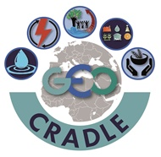
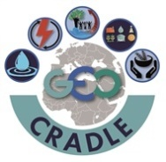
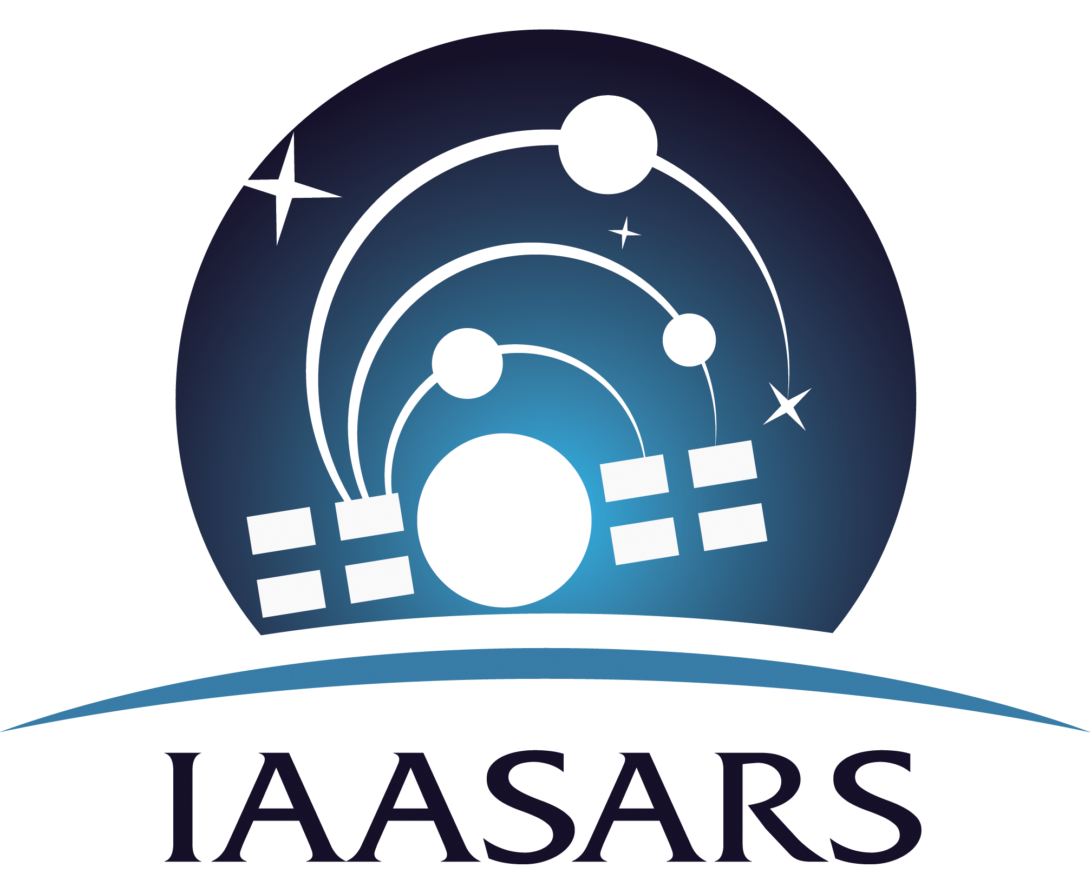
GEO-CRADLE:
Fostering regional cooperation and roadmap for GEO and Copernicus implementation in North Africa, Middle East and Balkans
Funded under H2020 - Climate action, environment, resource efficiency and raw materials
ACTIVITY: Developing Comprehensive and Sustained Global Environmental Observation and Information Systems
CALL IDENTIFIER: H2020 SC5-18b-2015 Integrating North African, Middle East and Balkan Earth Observation capacities in GEOSS
Project GA number: 690133
Total Budget: 2,910,800.00 €

Slide 2
GEO-CRADLE
… is a unique EU funded Coordination Action running at regional level;
… is looking at the territories of North Africa, Middle East and Balkans;
It seeks to identify common needs, create synergies, and integrate capacities;
Fosters the regional cooperation and integration of monitoring capabilities and networks, as well as scientific skills;
Proposes/sets up large scale regional initiatives based on the Earth Observation (space based and in-situ) for addressing societal priorities in different thematic aspects such as Adaptation to Climate Change, Access to Raw Materials, better exploitation of the renewable Energy resources, and Food Security.
Promote the uptake of EO services and data in response to regional needs.
Support the effective integration of existing Earth Observation Capacities in the region.
Facilitate the engagement of the complete ecosystem of EO stakeholders in the region.
Enhance the participation in and contribution to the implementation of GEOSS and Copernicus in North Africa, Middle East and the Balkans.
Objectives

Slide 3
Thematic Areas
Adaptation to Climate Change
(ACC)
Improved Food Security – Water Extremes Management
(IFS)
Access to Raw Materials
(ARM)
Access to Energy
(SENSE)

Slide 4
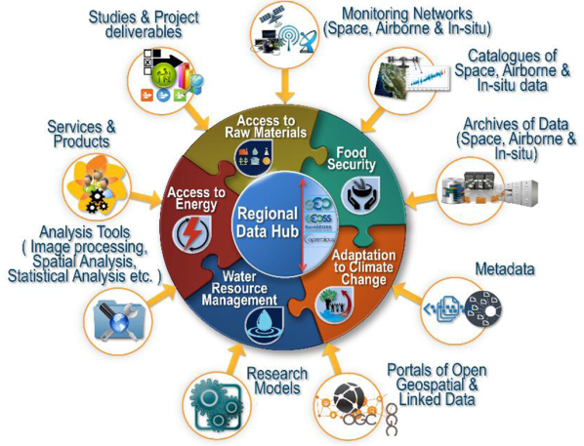
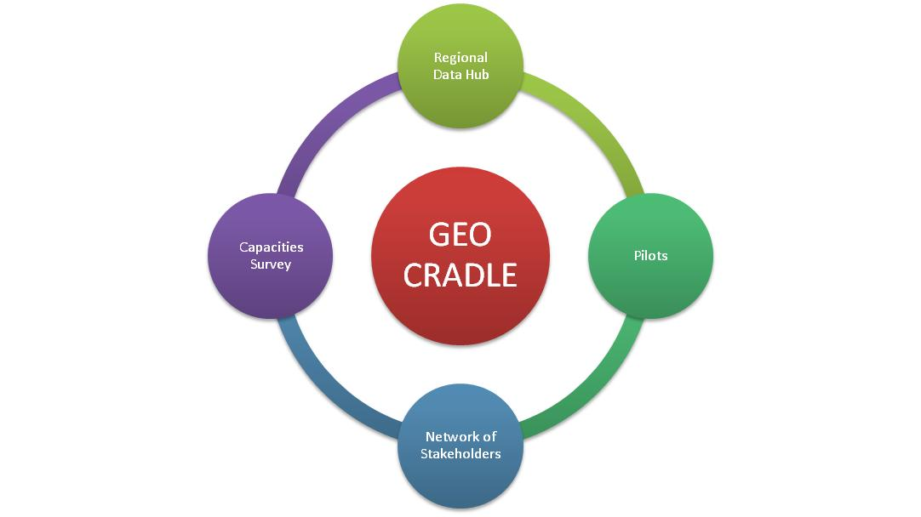
The Project Pillars
Visit: http://195.251.203.238/surveygeocradle/index.php/inventories/capacities/gc-survey1

Slide 5
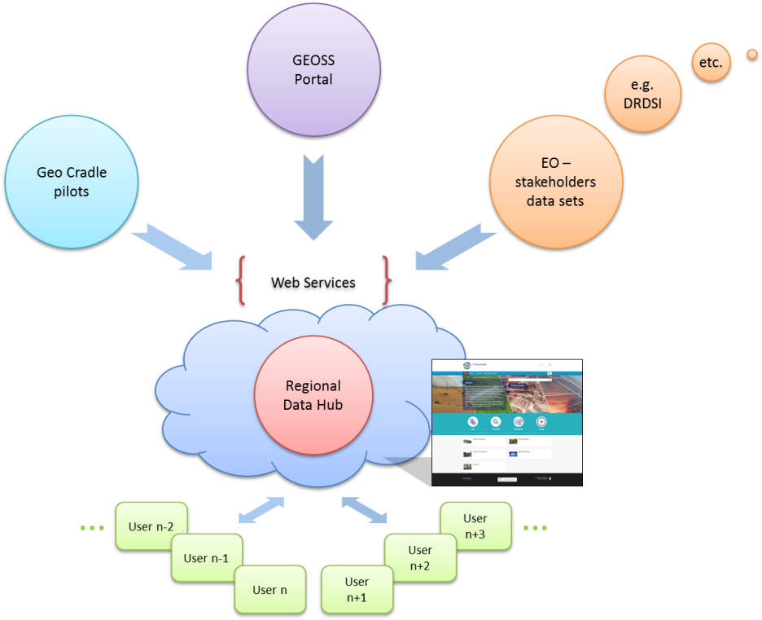
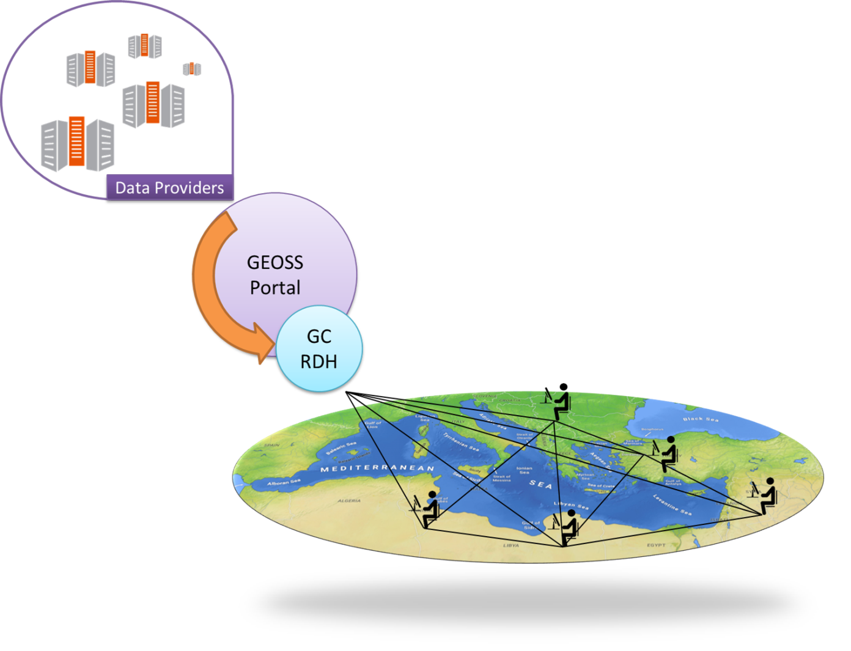
Regional Data Hub – Connection with GEOSS & Regional Portals
The GEO CRADLE Regional Data Hub (GC-RDH) is going to provide its users with a transparent discovery and access mechanism of the GEOSS portal’s resources, and other regional portals!
This mechanism will heavily rely on the GEO Discovery and Access Broker (DAB) APIs which is a middleware component in charge of interconnecting the heterogeneous and distributed capacities contributing to GEOSS; part of the GEOSS Common Infrastructure (GCI) since November 2011.

Slide 6
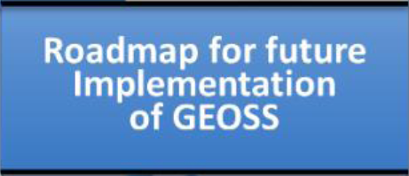
the implementation of GEOSS and the uptake of Copernicus in the RoI
Guides
Assesses
the readiness and maturity of each country in the RoI
Roadmap for future Implementation of GEOSS and Copernicus
the actions for the long-term response to major regional challenges in the RoI
Lays out
Paves
the ground for a potential regional large initiative

Slide 7
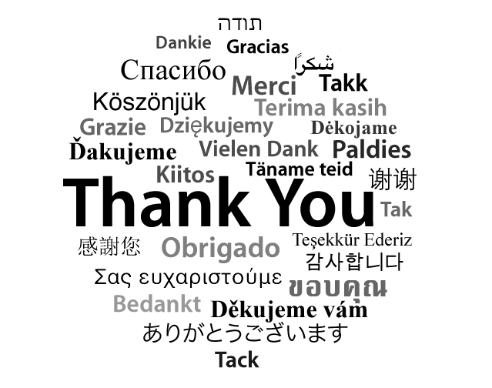
For more information
http://geocradle.eu/

